Slide 1
Probabilistic Intra-Surgical Guidance Tool for Balloon Angioplasty
John Lee
September 22, 2022 Update

Slide 2
Refresher

Slide 3
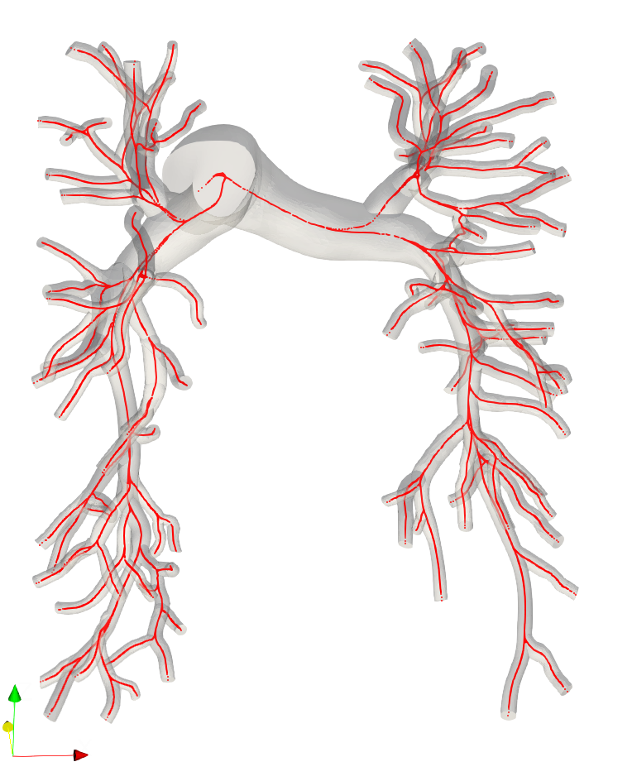
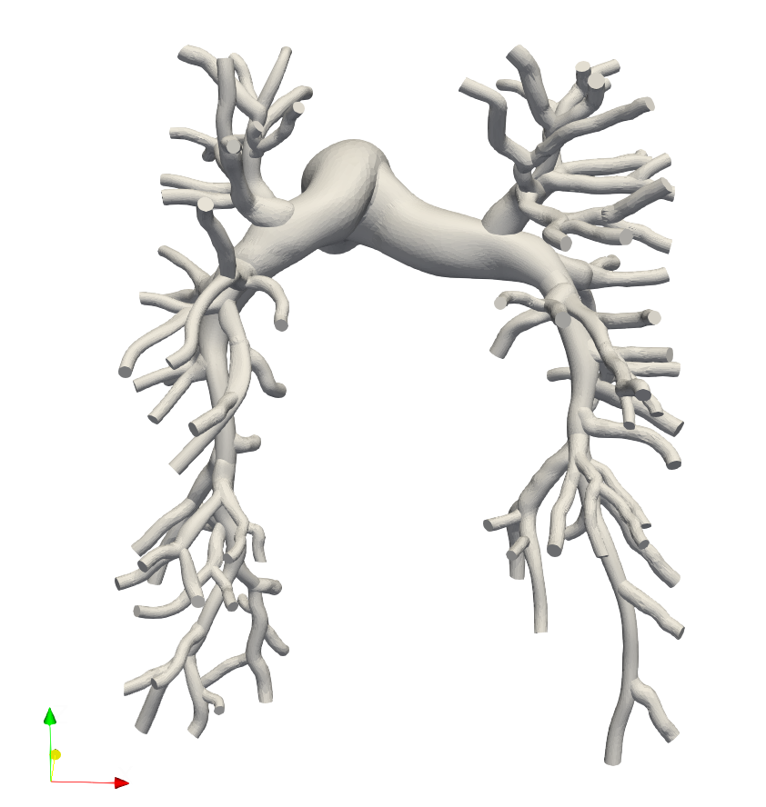
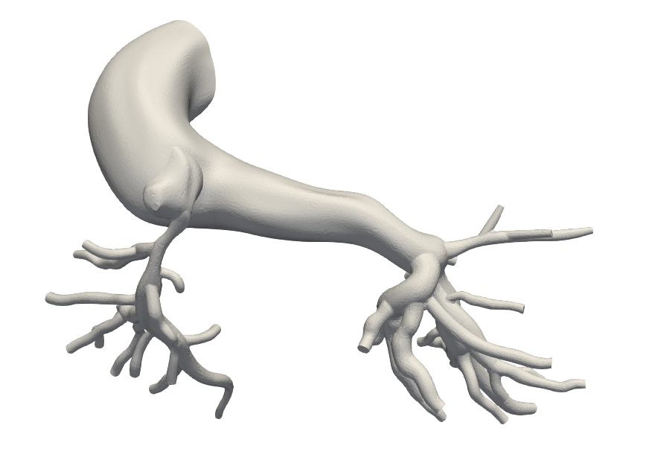
Model Gathering/LPN
0080_0001 (Healthy)
0118_1000 (Alagille)
Notes:
Read it off

Slide 4
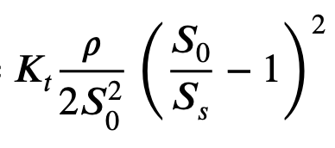
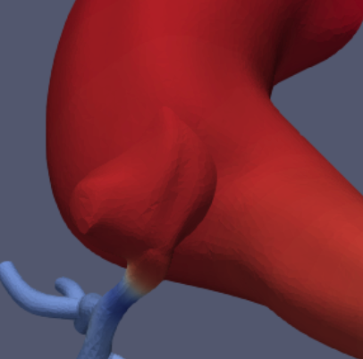
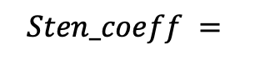
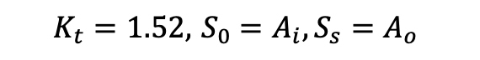
Junction Coefficients
$$Sten_coeff =$$
$$K_{t}=1.52, { S}_{0 }=A_{i}, S_{s}=A_{o}$$
Use vessel stenosis coefficient formula
Take inlet area of junction, and one outlet area, adding junction coeff to downstream vessel
Can be done after 0D pipeline as postprocessing
← Original
Stenosis coefficient is small
Junction Coeff →
Additional Junction coefficient is much larger

Slide 5
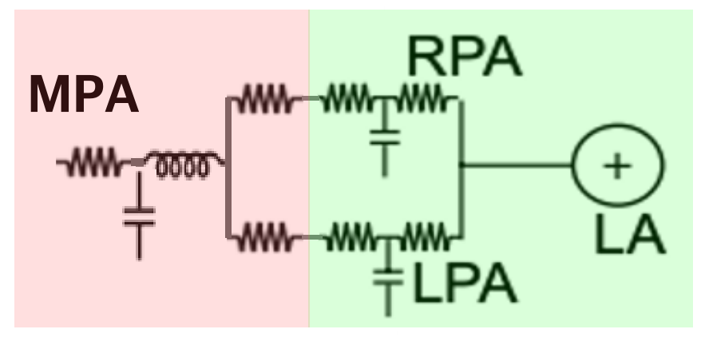
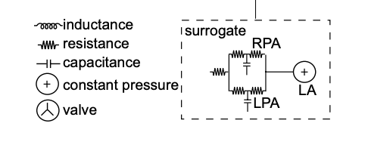
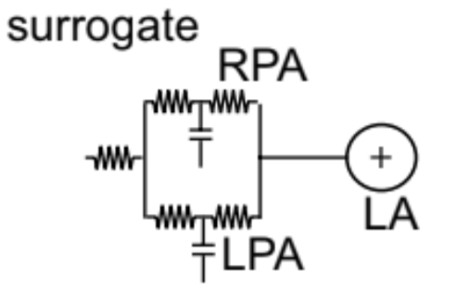
Healthy Models BC tuning
Yang et. al. 2019 Surrogate model (Modified)
Original
Solver-determined RCL values.
RPA/LPA resistances computed using resistances in series and parallel
Tunable RCR boundary conditions for LPA and RPA, with constant capillary wedge pressure of 7 mmHg
Notes:
We take a modified surrogate tuning model used by Weiguang in 2019.
We use solver computed RCL values for the MPA, and represent the RPA/LPA trees by a resistance computed using resistances in series and parallel
For actual tunable parameters, we set RCR boundary conditions for the RPA and LPA respectfully with a target capillary wedge pressure of 7

Slide 6
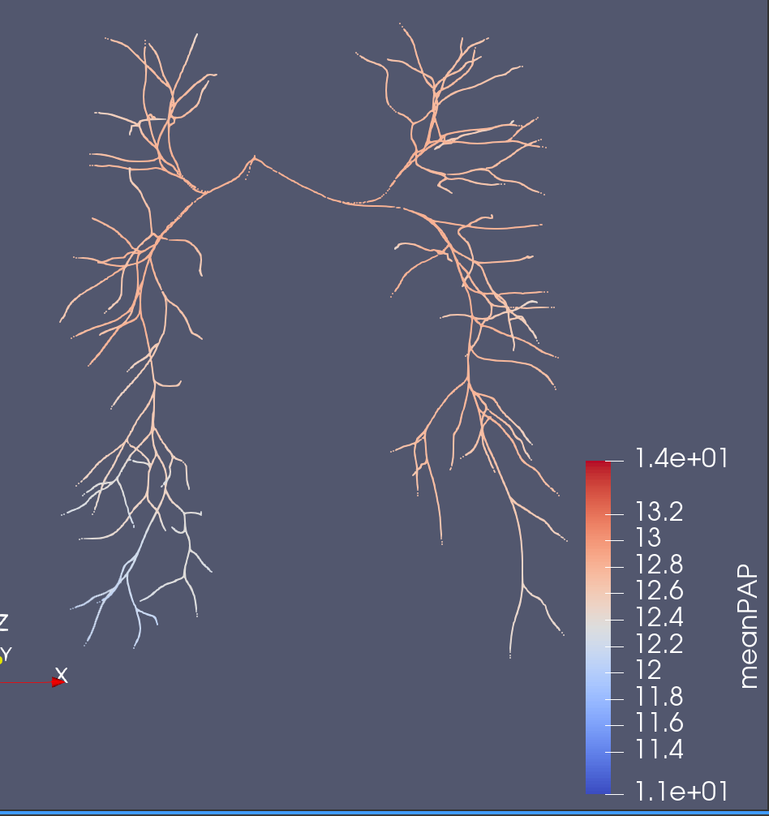
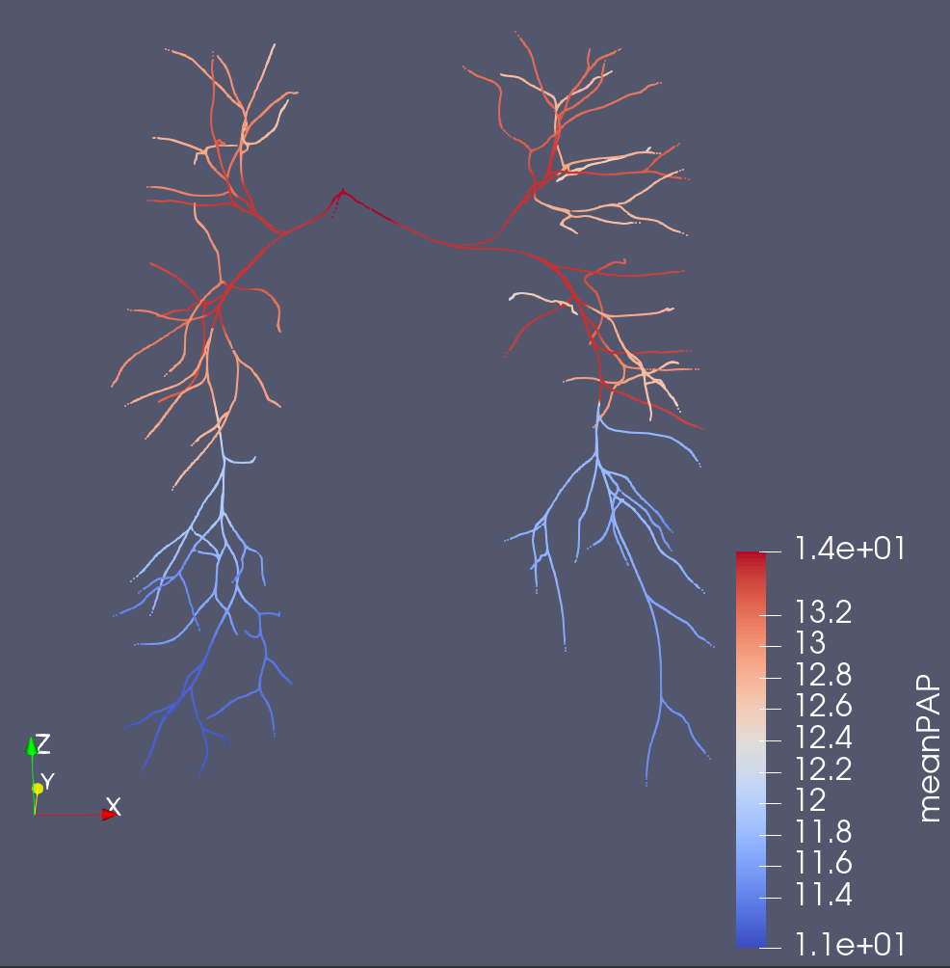
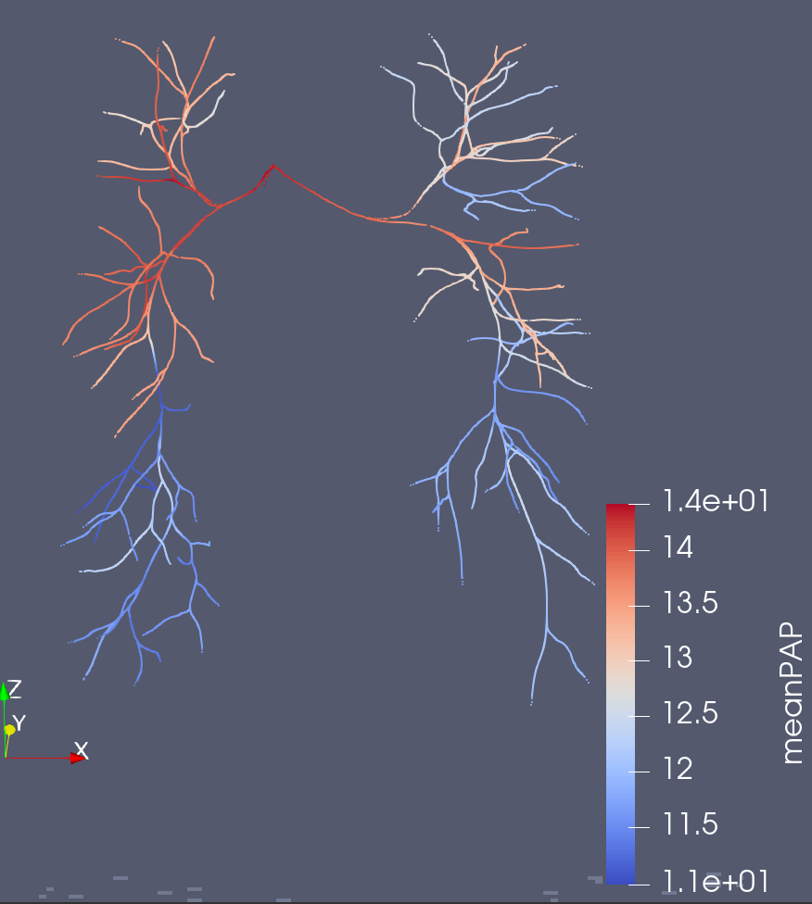
0080_0001 (meanPAP)
Original Solver
Junction Coefficient Solver
3D
Better Capture of the ~3 mmHg Pressure Drop

Slide 7
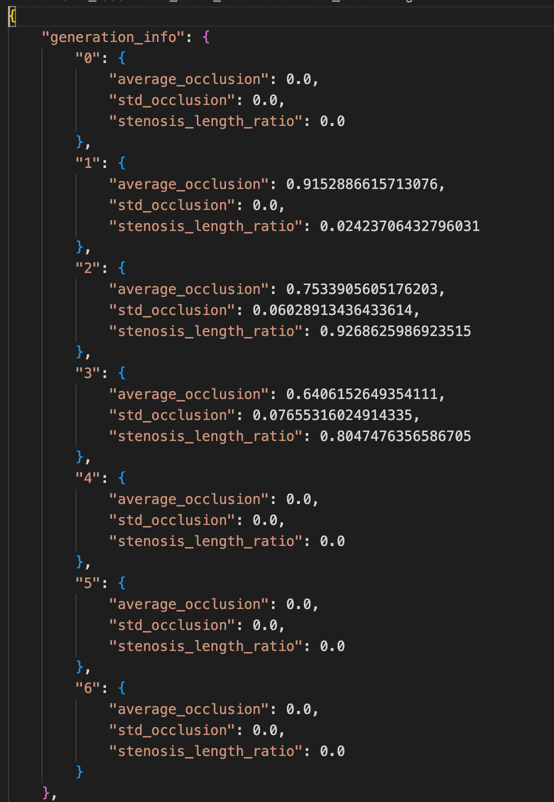
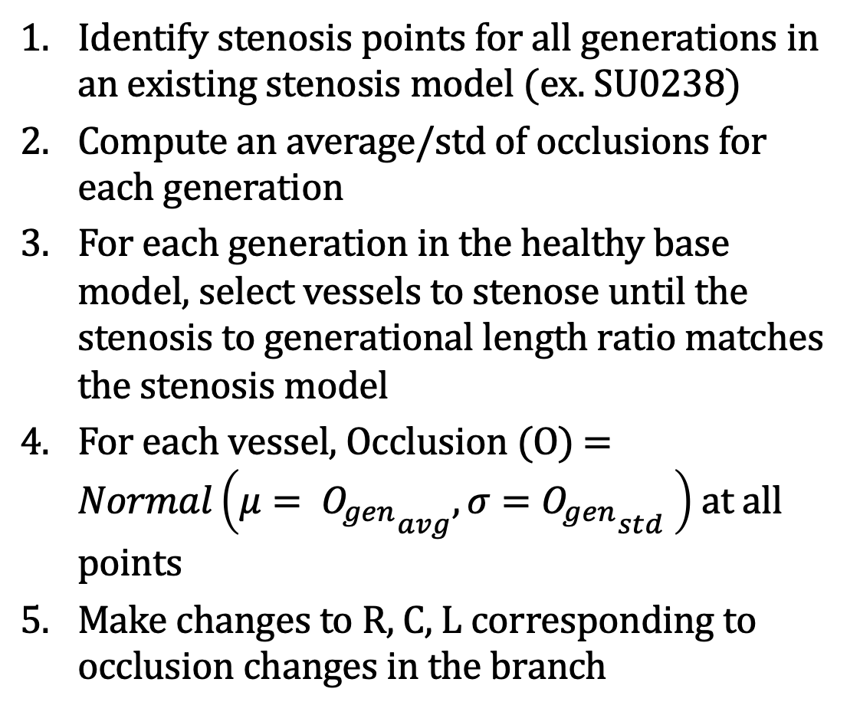
Artificial Stenosis – Healthy Models
Identify stenosis points for all generations in an existing stenosis model (ex. SU0238)
Compute an average/std of occlusions for each generation
For each generation in the healthy base model, select vessels to stenose until the stenosis to generational length ratio matches the stenosis model
For each vessel, Occlusion (O) = $Normal\left(μ= {O_{gen}}_{avg},σ={O_{gen}}_{std} \right)$ at all points
Make changes to R, C, L corresponding to occlusion changes in the branch
Config File for SU0238
Notes:
We are considering making a change, so rather than probability based, we will try to match stenosis according to one of Ingrid’s models and observe the change.

Slide 8
Current Update

Slide 9
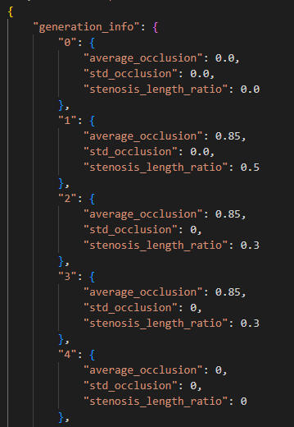
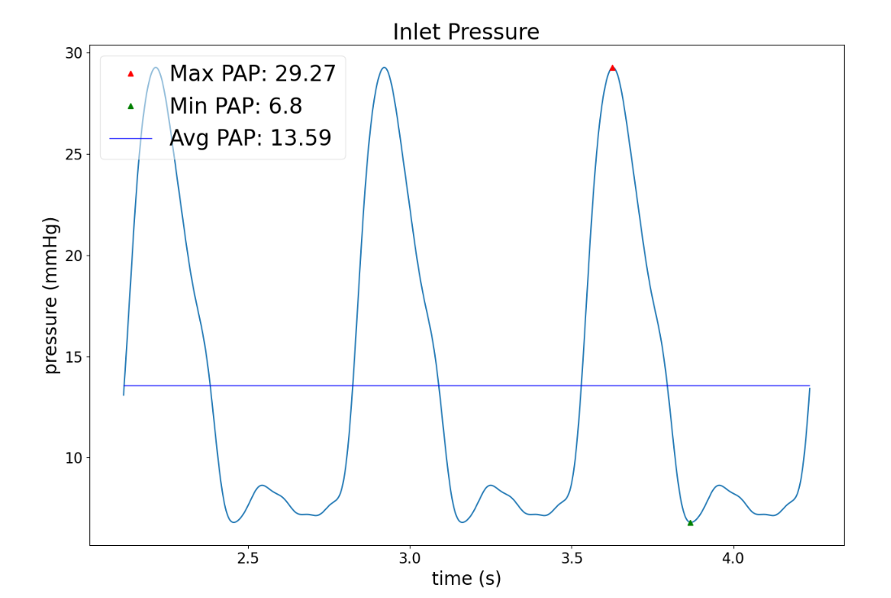
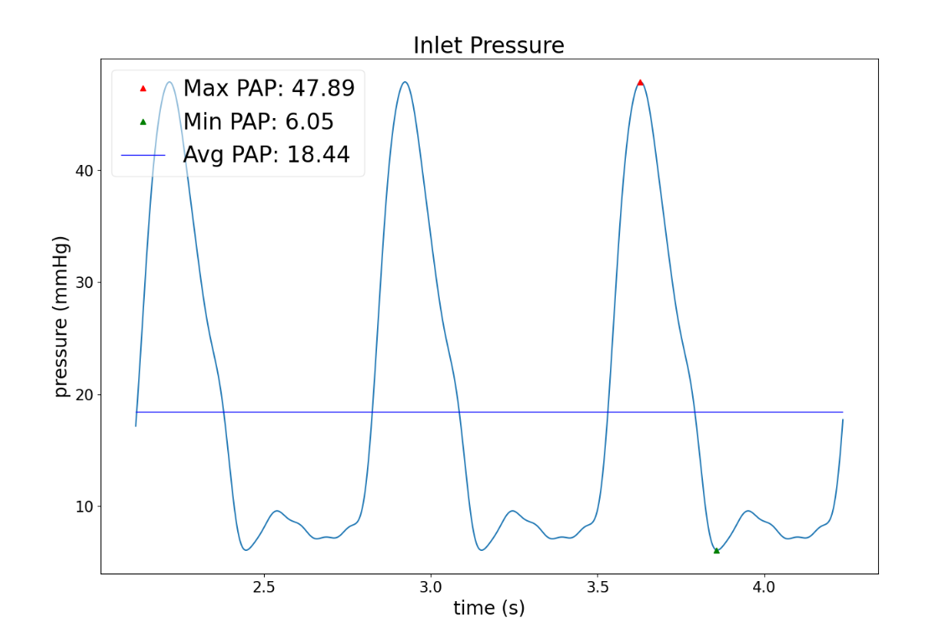
Manual Artificial Stenosis
Originally designed for matching stenosis in an actual model.
Manually selected an occlusion level of .85 (meaning stenosis values are 15% of original)
Stenosis_length_ratio determines how much of the total length in a generation is stenosed (randomly selected)
Make changes to R, C, L corresponding to occlusion changes in the branch
Manual Config File
Before
After
Notes:
We are considering making a change, so rather than probability based, we will try to match stenosis according to one of Ingrid’s models and observe the change.

Slide 10
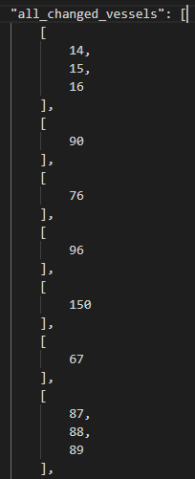
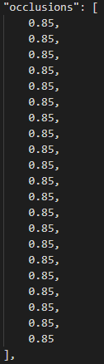
Stenosis File (Healthy Model)
Contains each stenosis point (branches or vessels)
Contains Occlusions for each point
Other metadata useful in representing a potential full repair (unused)

Slide 11
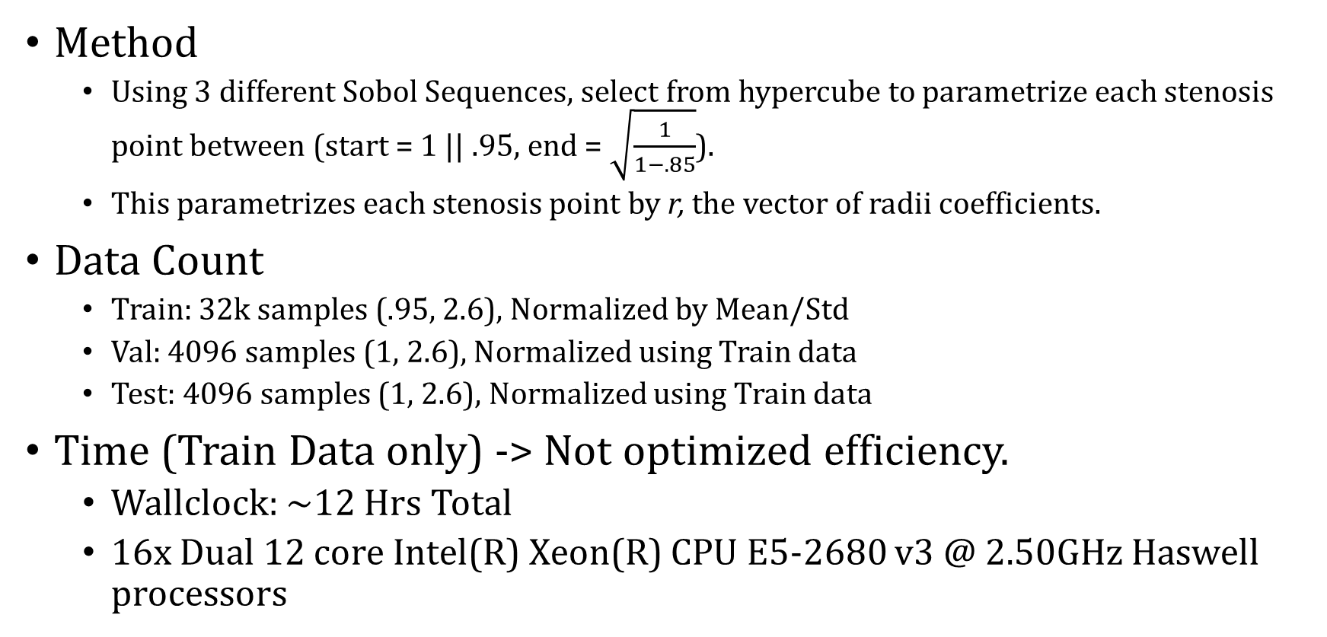
Data Generation
Method
Using 3 different Sobol Sequences, select from hypercube to parametrize each stenosis point between (start = 1 || .95, end = $\sqrt{\frac{1}{1−.85}}$).
This parametrizes each stenosis point by r, the vector of radii coefficients.
Data Count
Train: 32k samples (.95, 2.6), Normalized by Mean/Std
Val: 4096 samples (1, 2.6), Normalized using Train data
Test: 4096 samples (1, 2.6), Normalized using Train data
Time (Train Data only) -> Not optimized efficiency.
Wallclock: ~12 Hrs Total
16x Dual 12 core Intel(R) Xeon(R) CPU E5-2680 v3 @ 2.50GHz Haswell processors

Slide 12
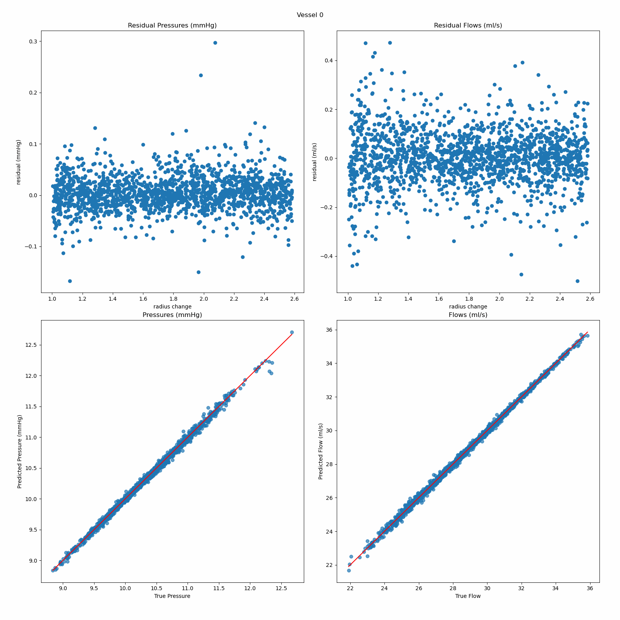
Starter Model
Architecture
n inputs, 2n outputs
3 hidden layers, 1000 neurons each
ReLU Activation layers.
Training
Reduce LR on Plateau (1e-3 start)
Checkpoint best validation loss
MSE Loss
Batch Size 128
Error:
Max Relative Error = ~12%
Avg Relative Error = .408%

Slide 13
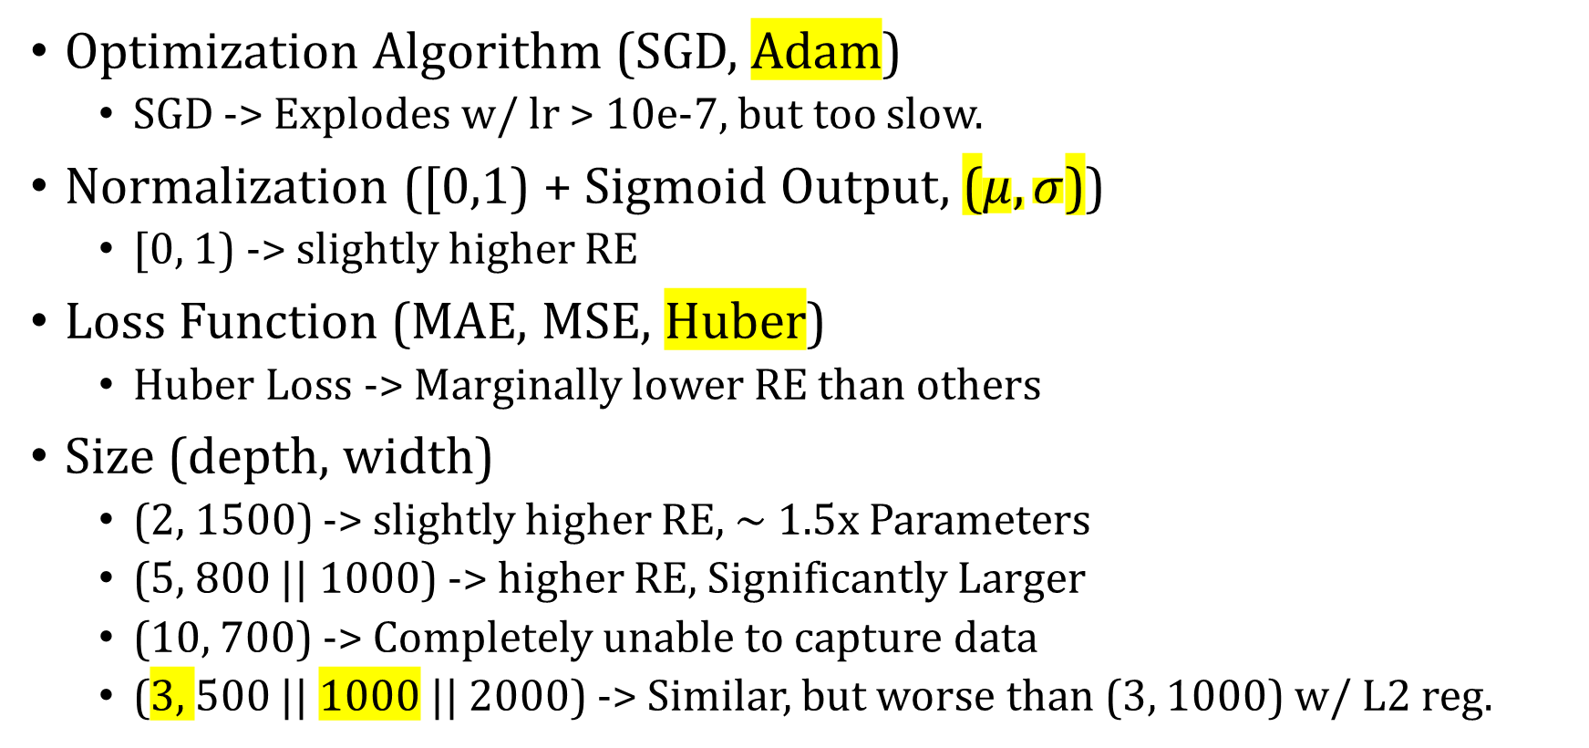
Summary of Small Tests
Optimization Algorithm (SGD, Adam)
SGD -> Explodes w/ lr > 10e-7, but too slow.
Normalization ([0,1) + Sigmoid Output, ($μ,σ$))
[0, 1) -> slightly higher RE
Loss Function (MAE, MSE, Huber)
Huber Loss -> Marginally lower RE than others
Size (depth, width)
(2, 1500) -> slightly higher RE, ~ 1.5x Parameters
(5, 800 || 1000) -> higher RE, Significantly Larger
(10, 700) -> Completely unable to capture data
(3, 500 || 1000 || 2000) -> Similar, but worse than (3, 1000) w/ L2 reg.

Slide 14
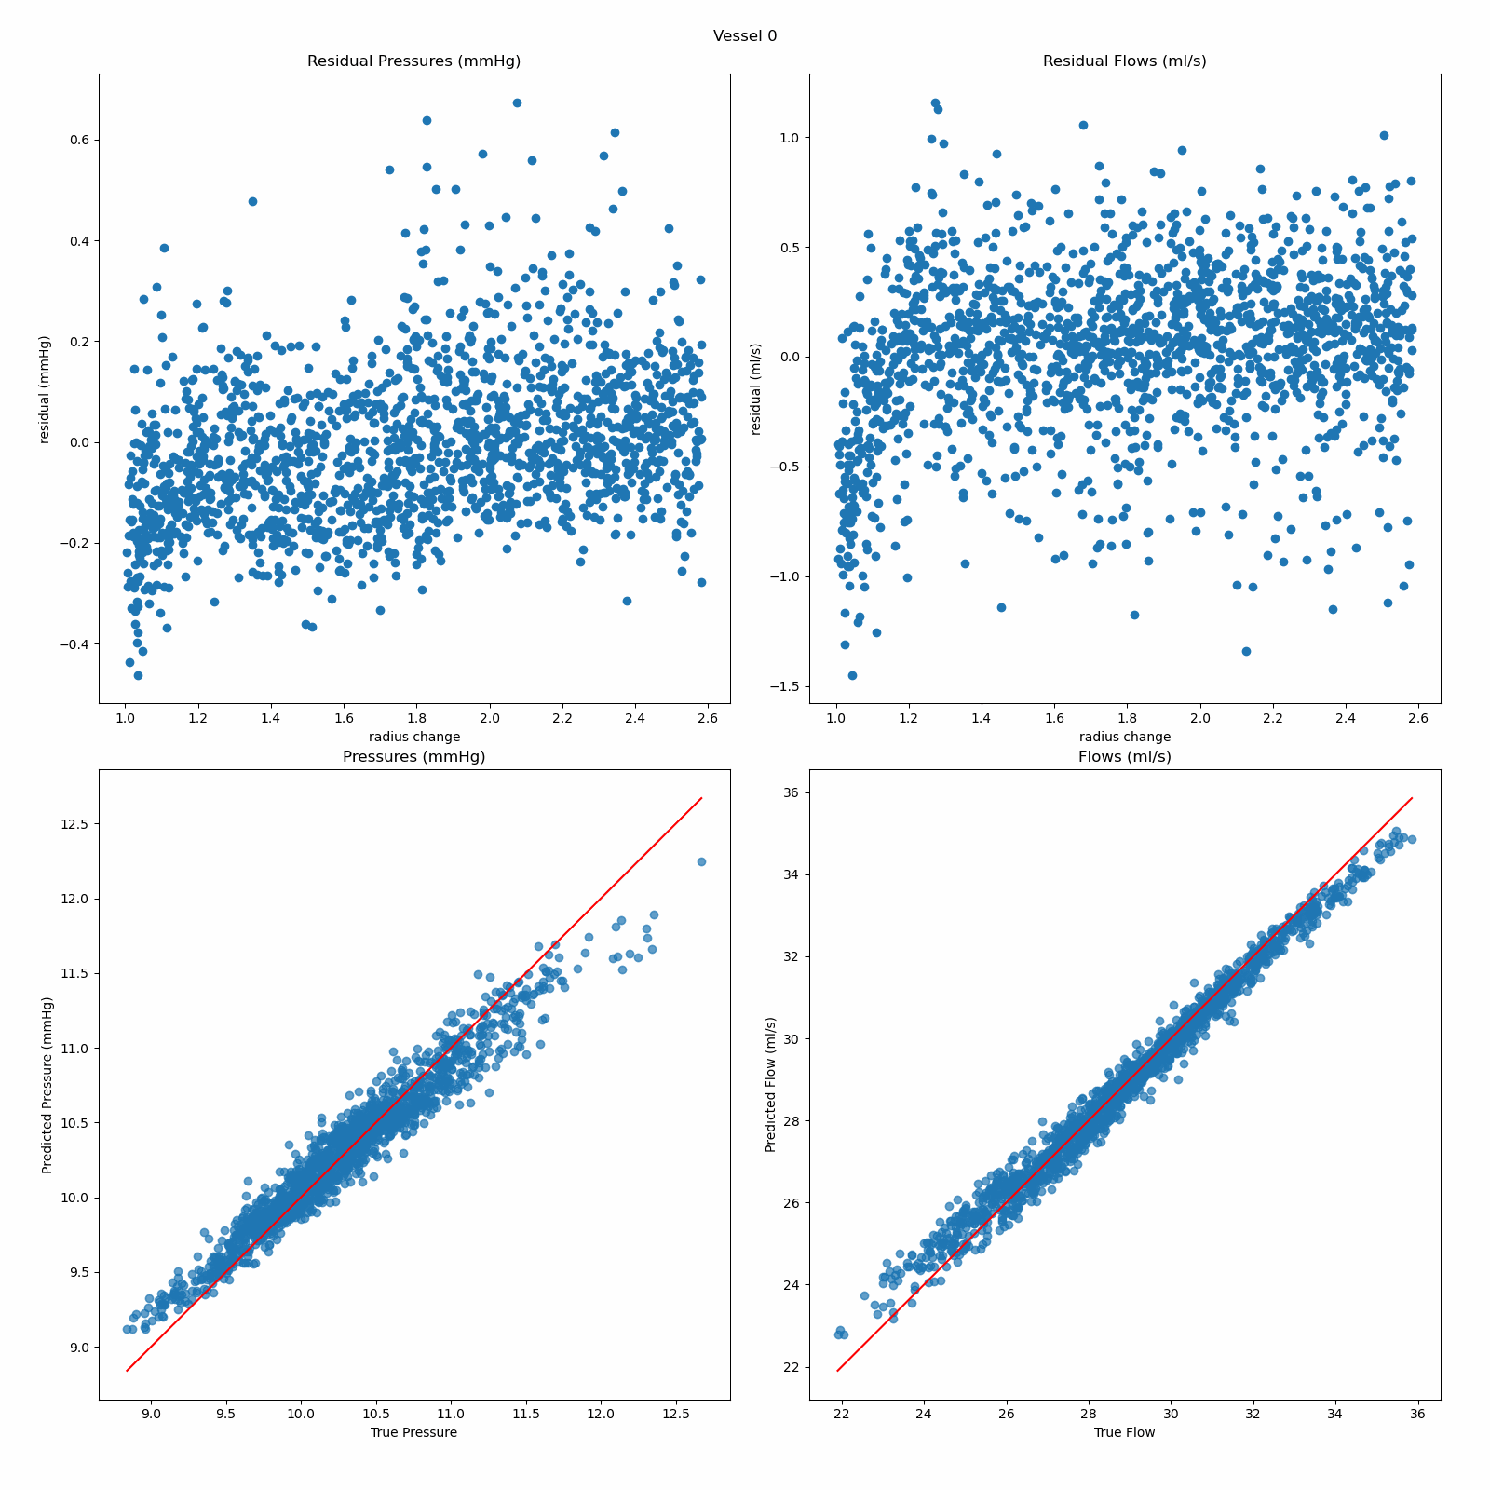
Dropout
Add drop_prob = .2 at start and .5 elsewhere
Progressively less dropout only reduced error, but never lower than without dropout

Slide 15
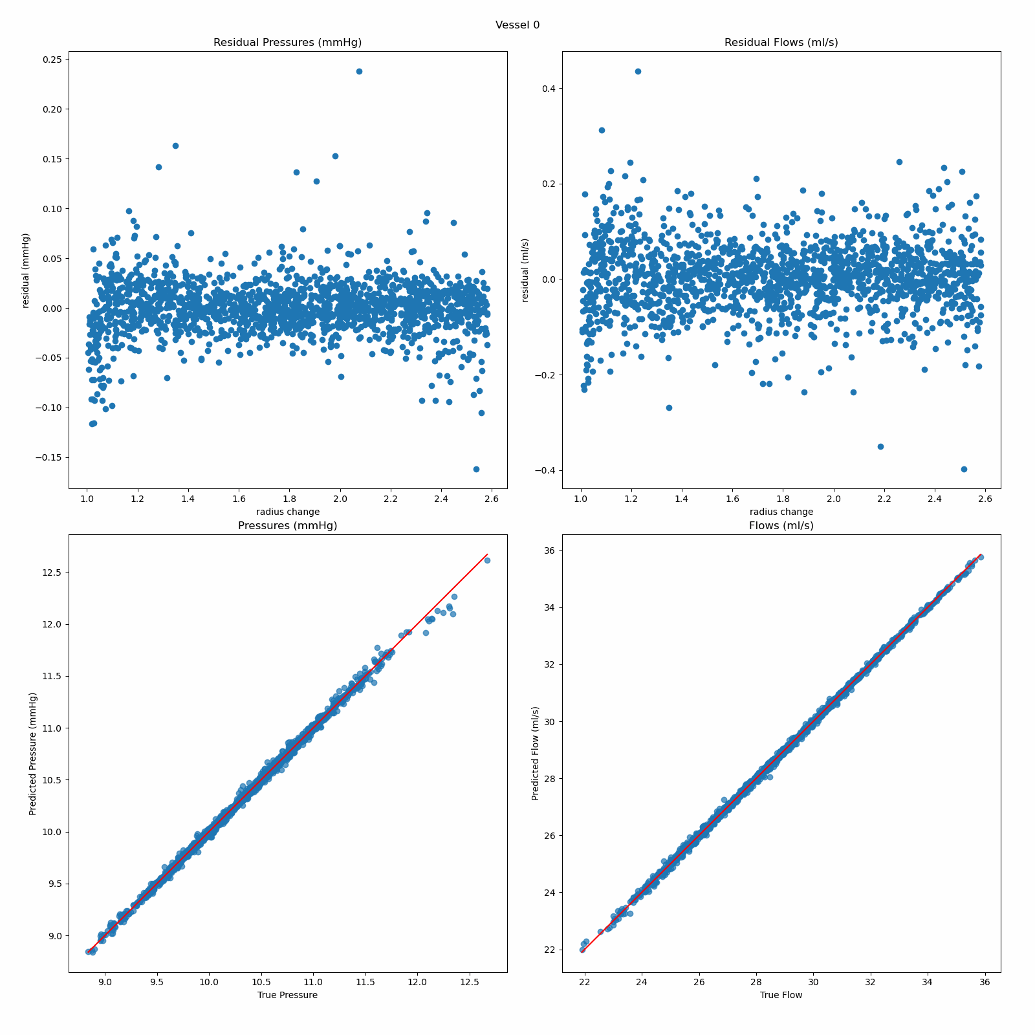
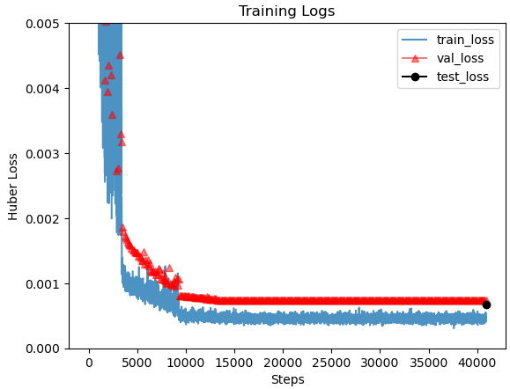
L2 Regularization
Using Adam Weight Decay
> 1e-4, unable to converge properly
Best Results around 5e-5 -> ~.1% AvgRE improvement, but ~1% higher MaxRE
Exhasperated edge effect
Still unable to match validation and train losses

Slide 16
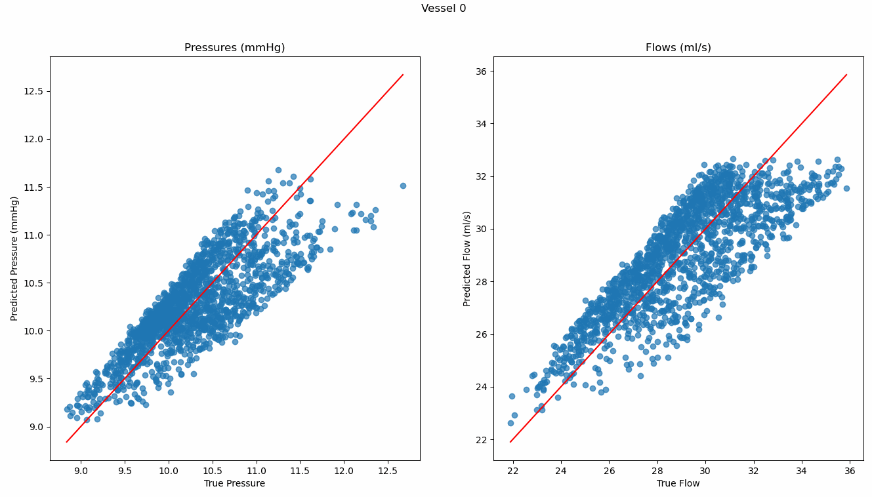
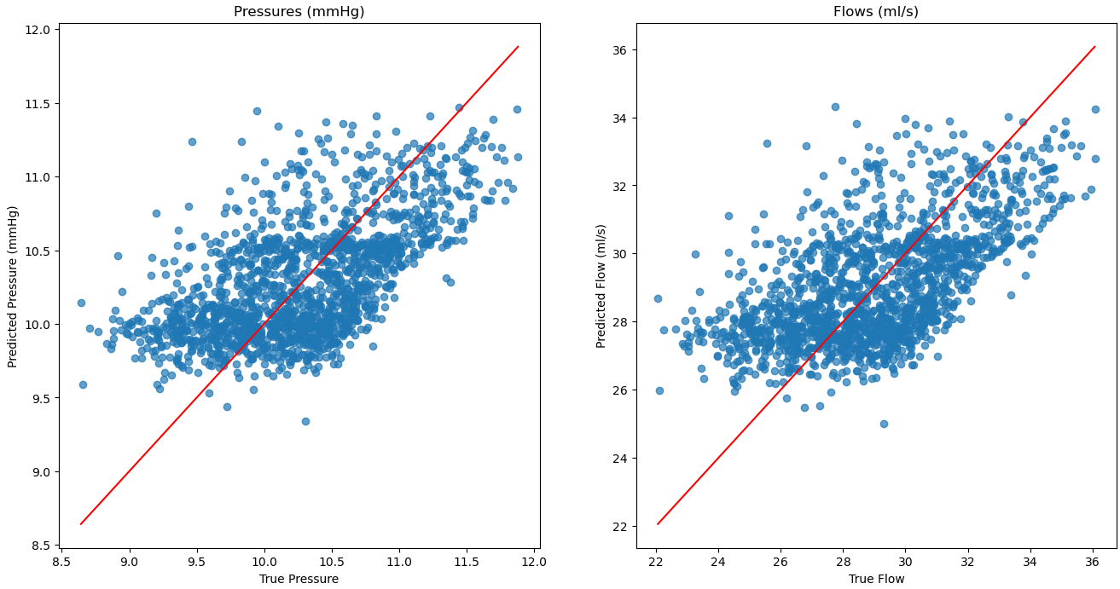
Intuition of Problem
Attempting to predict Gen 1 from only Gen 1 vessels
Attempting to predict a single gen 2 only using Gen 1 vessels

Slide 17
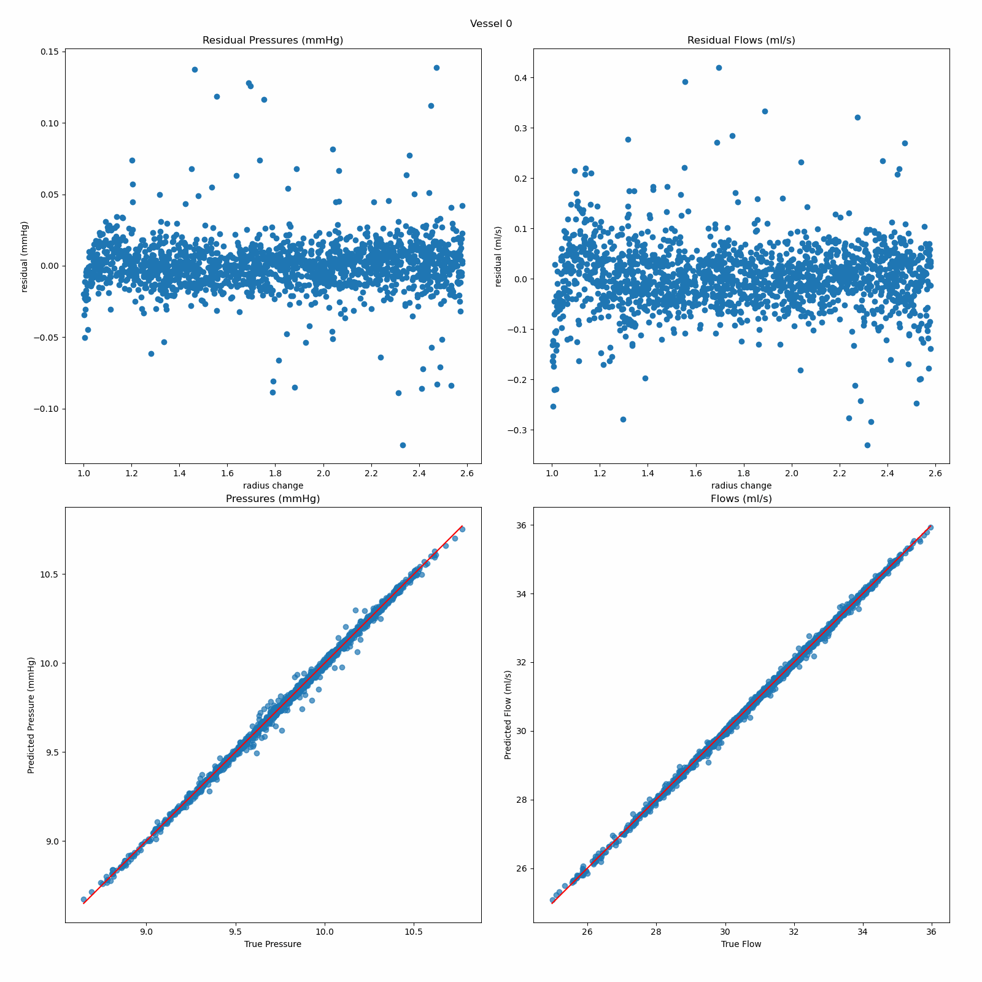
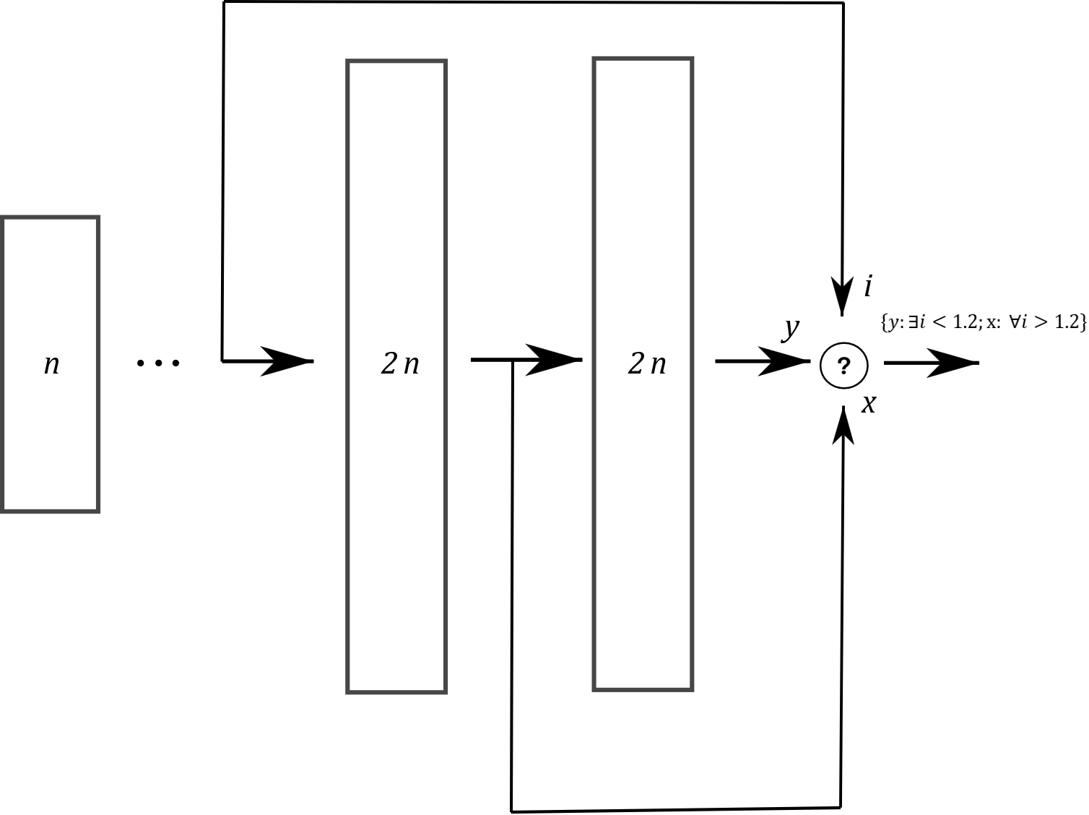
Difference Models
Attempt to approximate difference
Other similar models

Slide 18
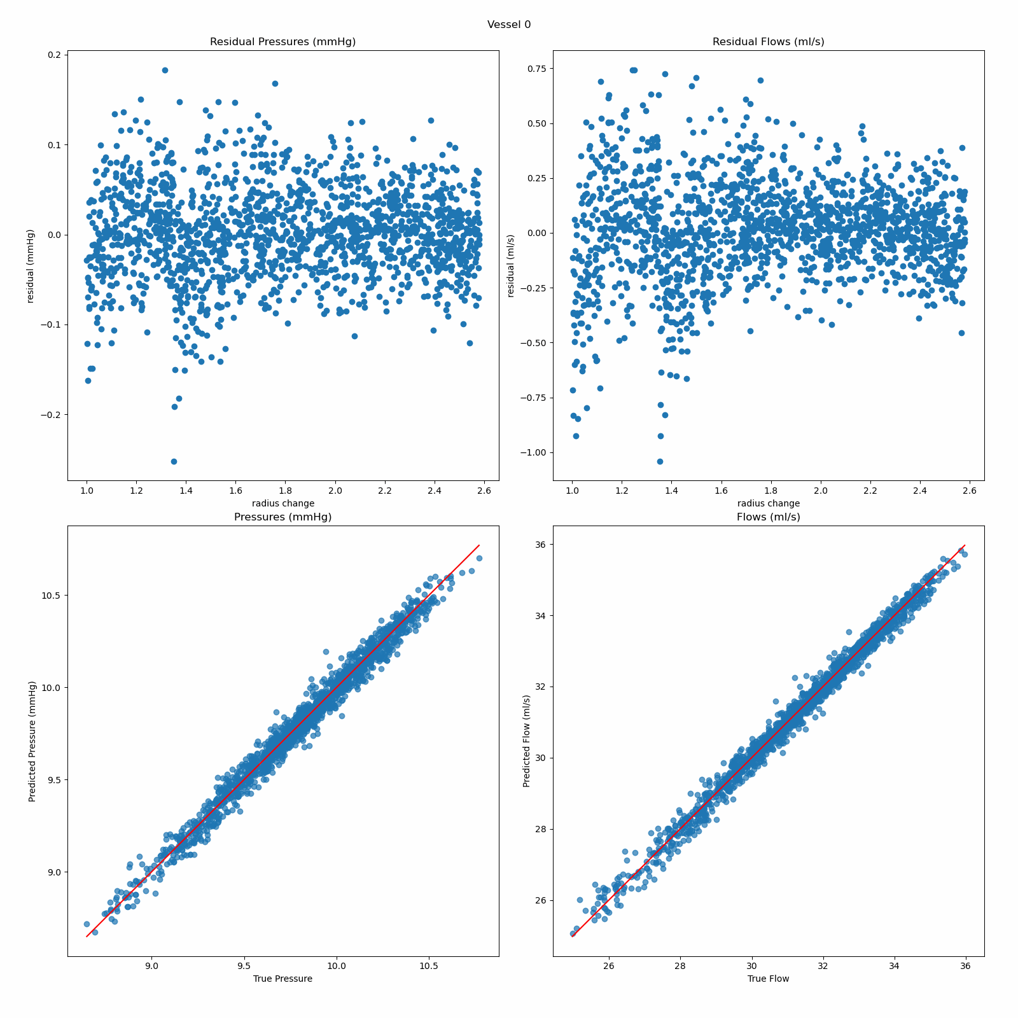
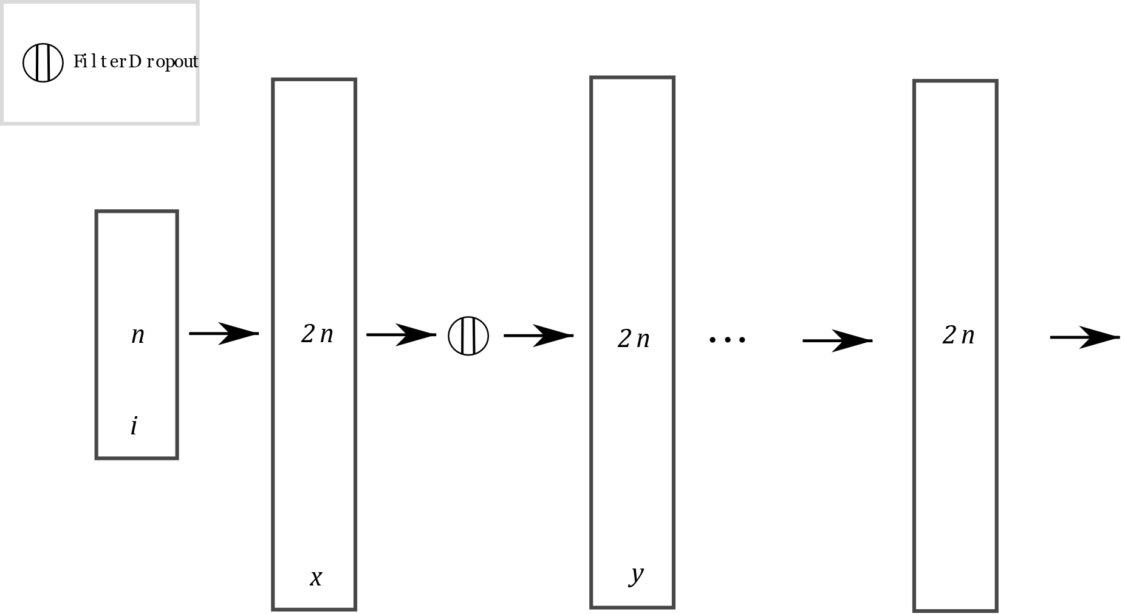
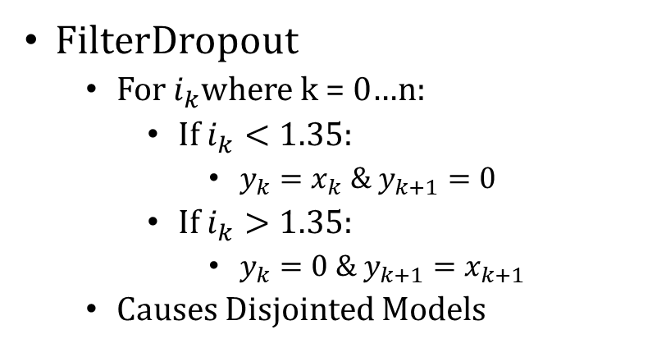
Filter Dropout Model
FilterDropout
For $i_{k}$where k = 0…n:
If $i_{k}<1.35$:
$y_{k}=x_{k} \&$ $y_{k+1}=0$
If $i_{k}>1.35$:
$y_{k}=0 \&$ $y_{k+1}=x_{k+1}$
Causes Disjointed Models

Slide 19
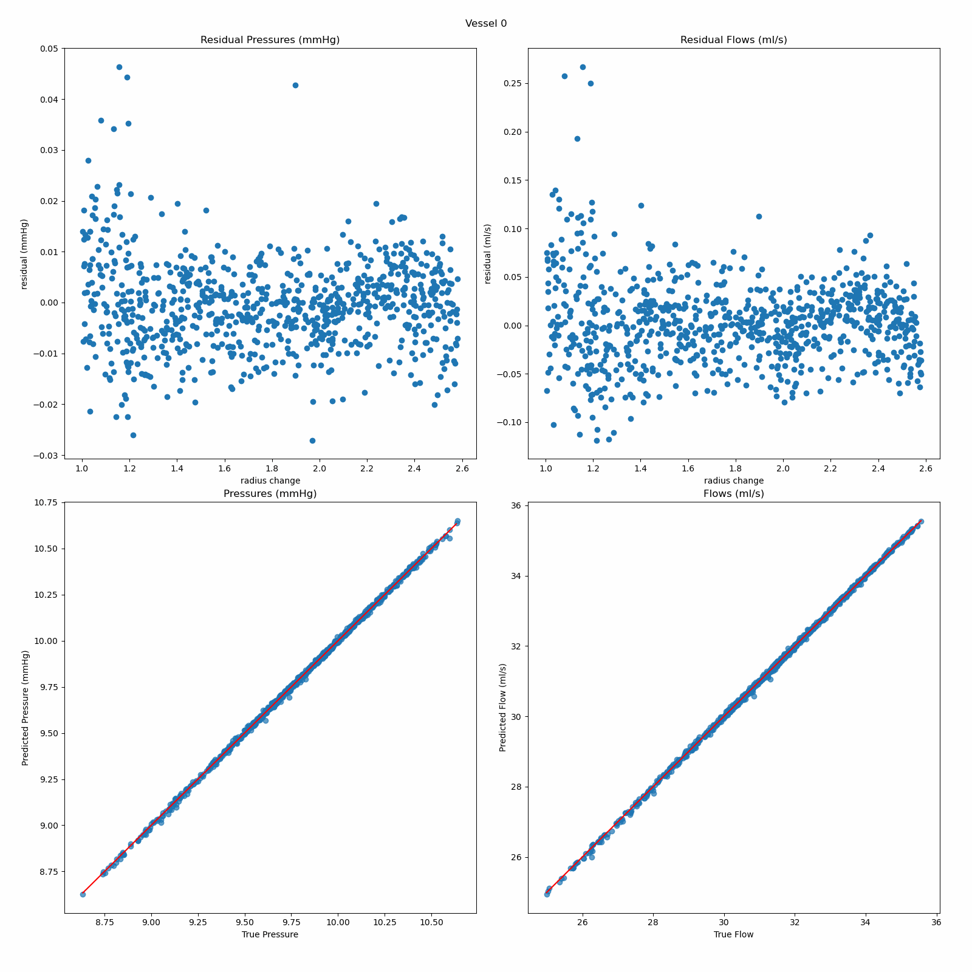
Easier Solution
Shift lower bound so the error occurs in a range we are not interested in
Problems:
Sampled Space (1.6/1.65)^21 = .52 original
Validation/Test sets reduced
Hence, we generate samples 16k train (.95, 2.6)*, 4k val/test (1, 2.6)
Errors:
Reduced MaxRE from 11%-> 7%
AvgRE about the same
*Still ~50% reduced sample space

Slide 20
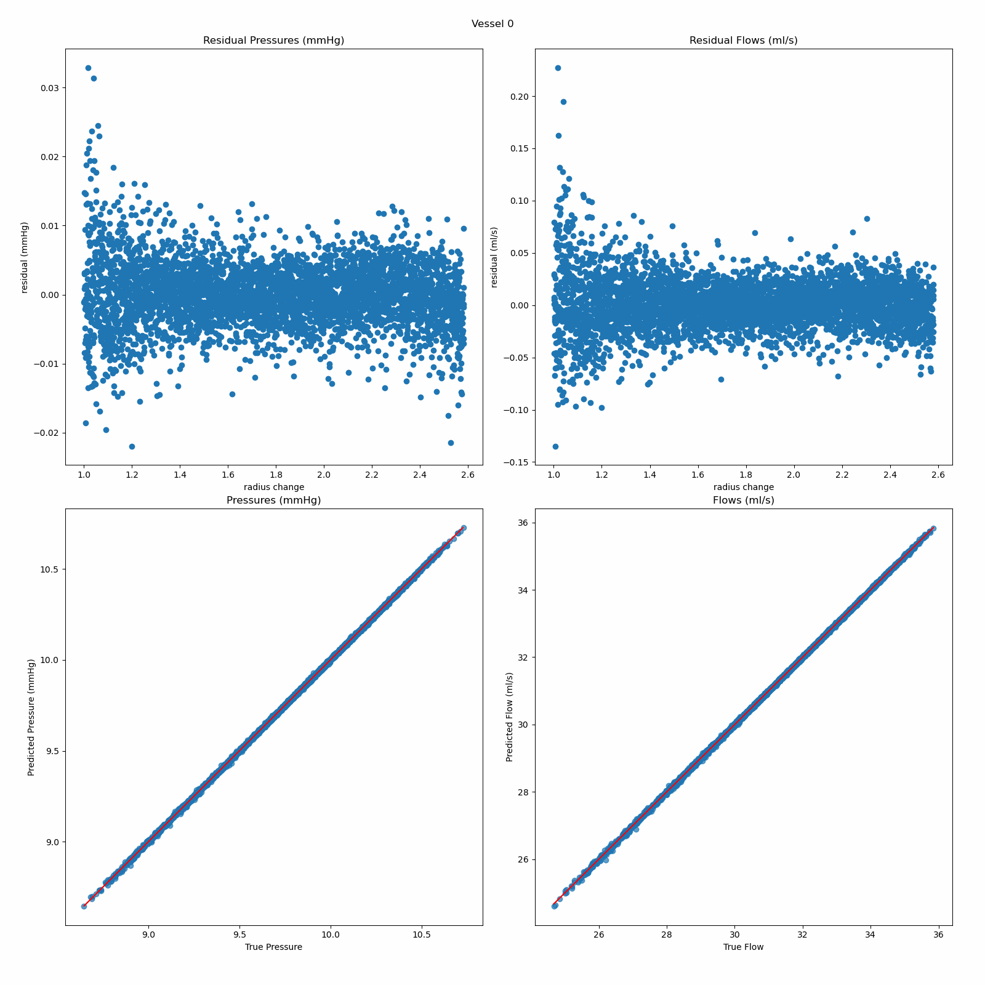
Changing Activation Functions
Instead of ReLU, we test Sigmoid and Tanh internal activation functions
Tanh > Sigmoid > ReLU
Furthermore, we no longer need L2 Regularization
Errors (with Tanh):
MaxRE = 10% -> 4.3%
AvgRE = .256% -> .123%

Slide 21
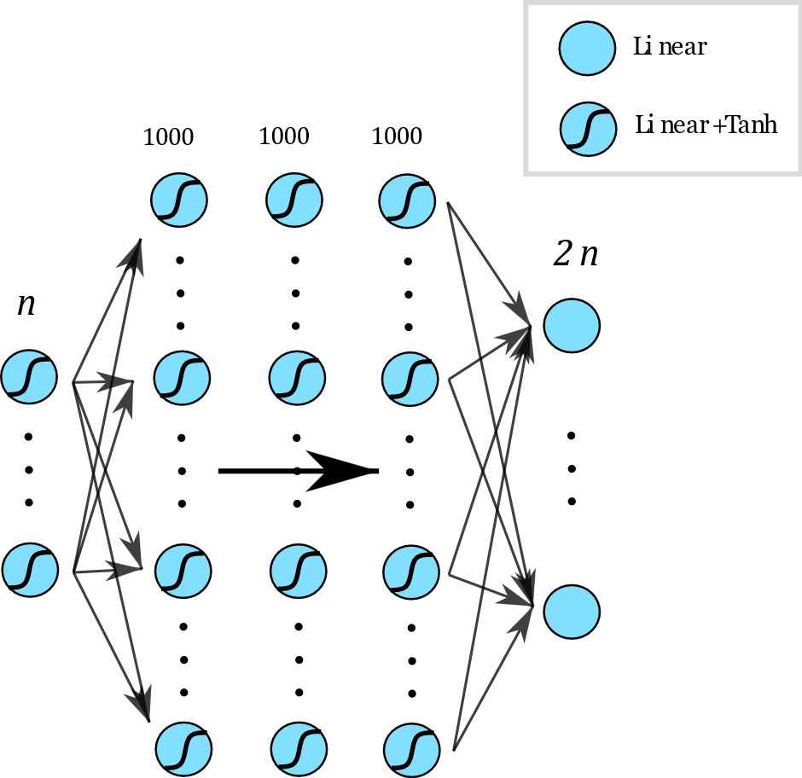
Best Model (Doubled Data)
Architecture
n inputs, 2n outputs
3 hidden layers, 1000 neurons each
Tanh Activation layers.
Training
Reduce LR on Plateau (1e-3 start), Adam Optimizer
Checkpoint best validation loss
Huber Loss
Batch Size 128
< 5 minutes on Nvidia 3080ti
Results:
Max Relative Error: 2.334%
Avg Relative Error: 0.068%

Slide 22
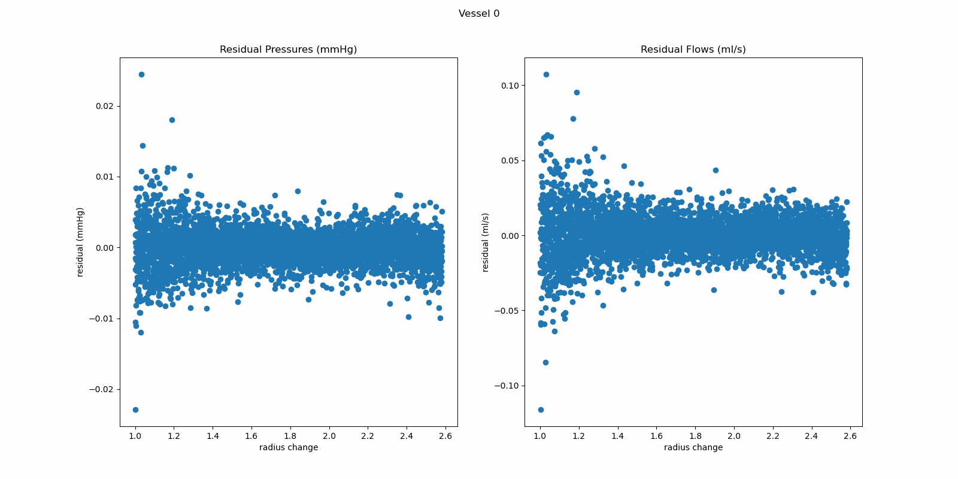
Best Model Residuals

Slide 23
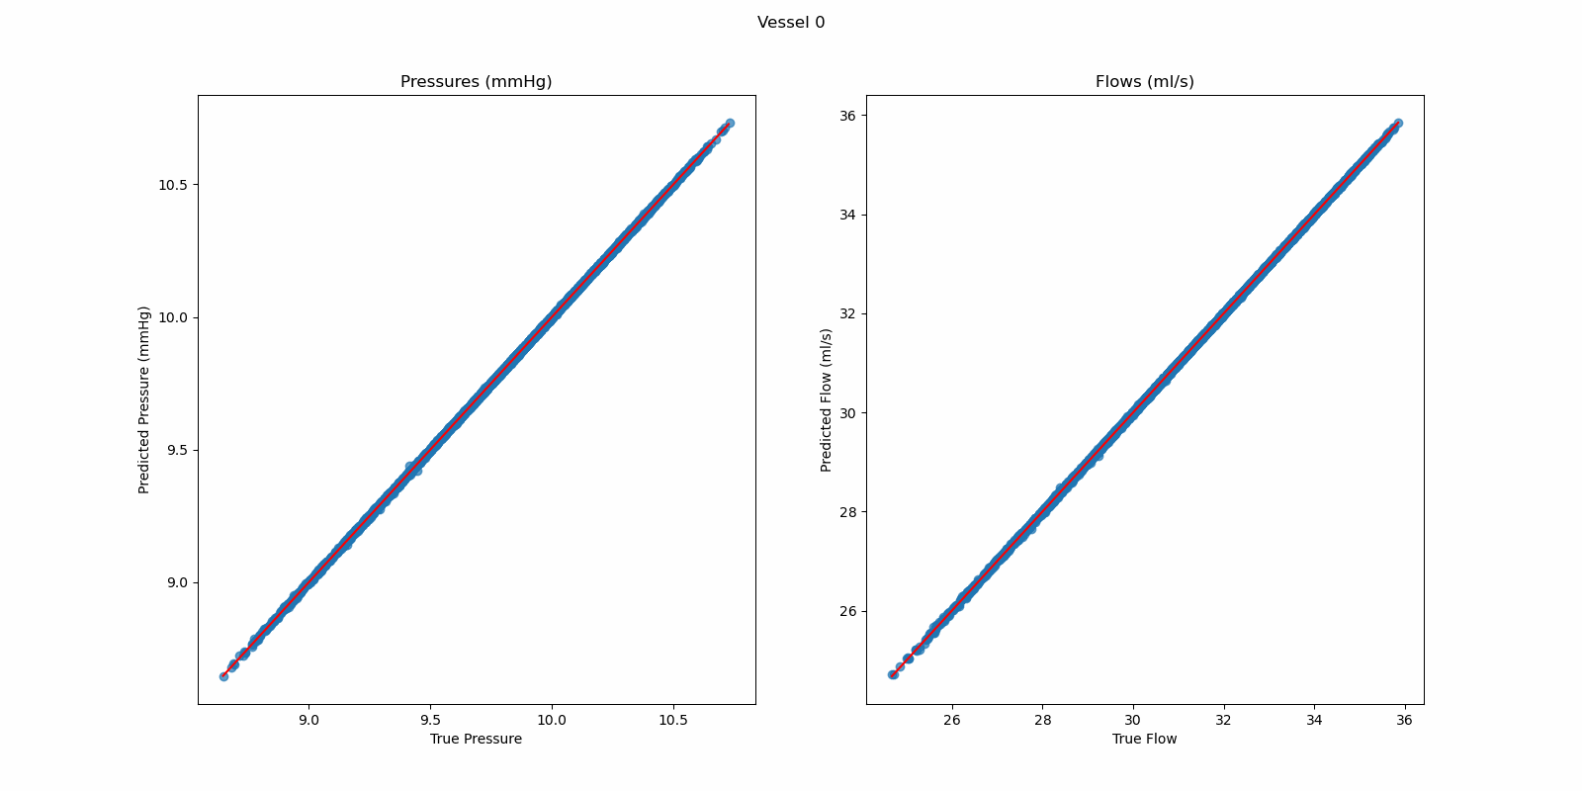
Best Model – Predicted vs. Actual

Slide 24
Probability Modeling
Fixed -> Intervention has already occurred.
Random -> We can sample from (1, Max)
Frozen -> Sample always returns 1 (to isolate effects of other interventions)

Slide 25
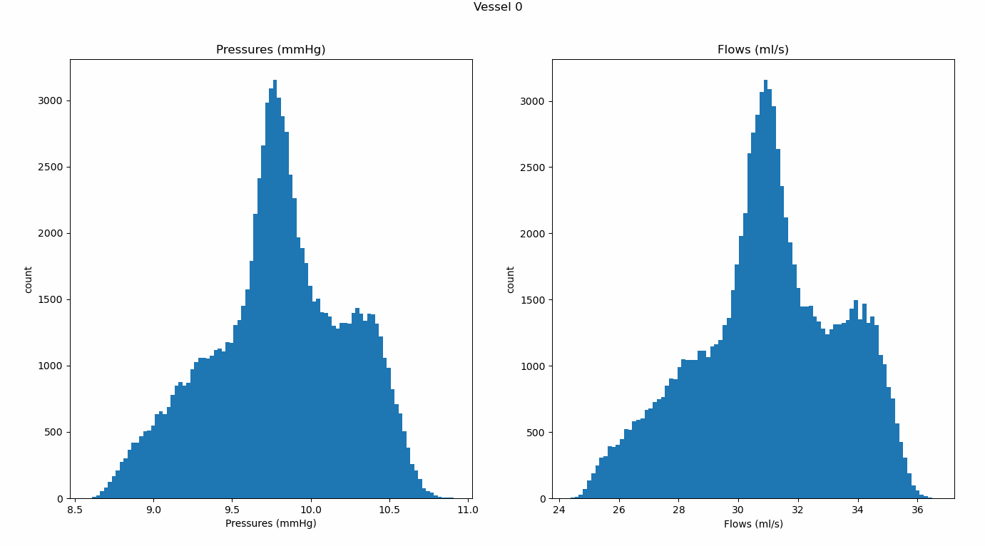
All Random

Slide 26
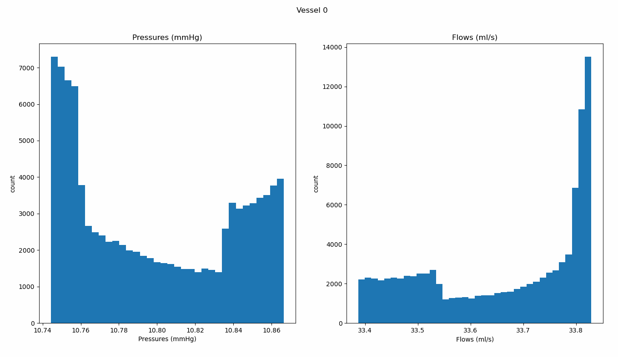
First 3 Fixed (1.5, 2.1, 1.9), 1 Random, Rest Frozen

Slide 27
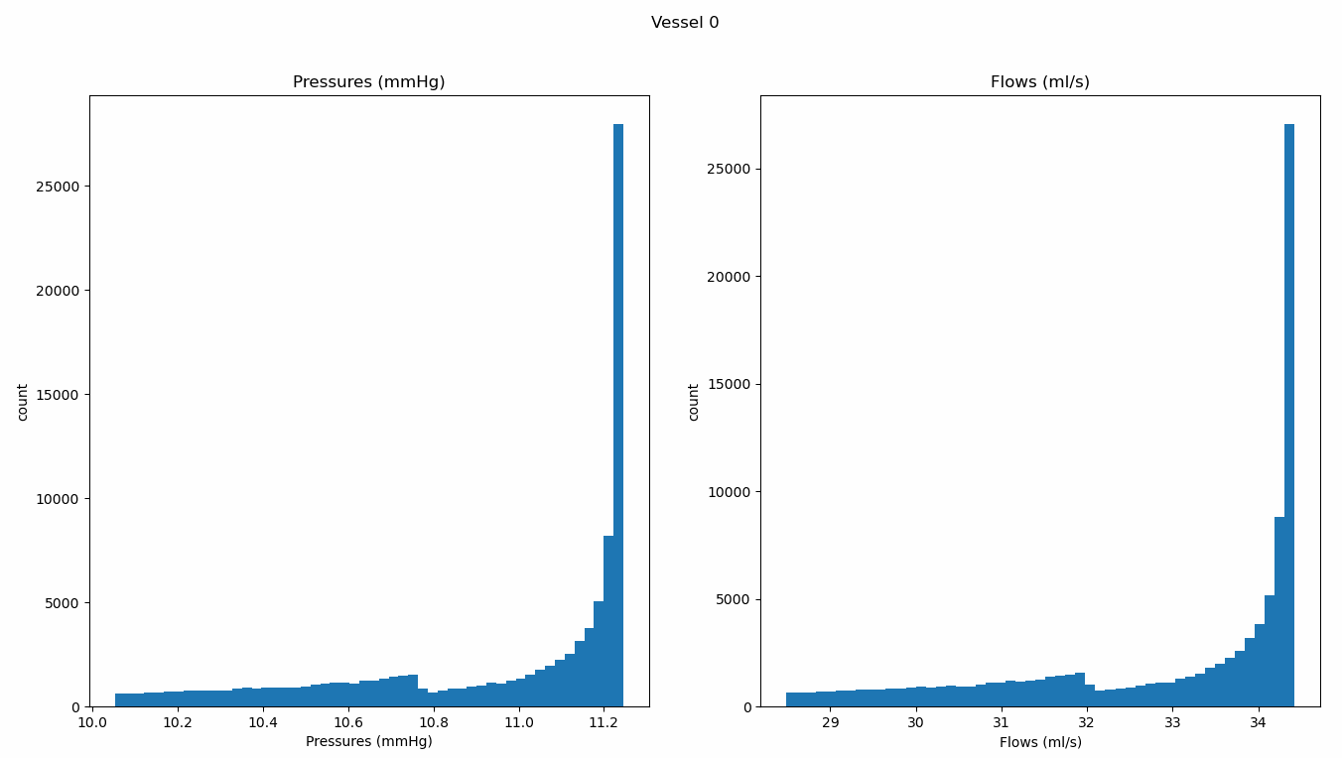
1st Free, Rest Frozen
It seems wrong, but it is entirely possible that fixing a higher generation first is not the most optimal

